Slide 1
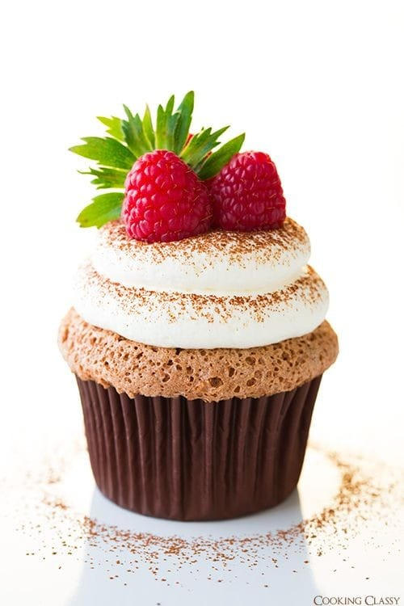
Frosty Bites: Where Sweet Dreams Come True

Slide 2
About Frosty Bites
Our Journey
Our Journey
Frosty Bites began as a small family dream in 2020. Inspired by a love for baking and a desire to create joy, we opened our doors to share our passion with the community. Over the years, we have grown, but our values remain the same—providing delicious cupcakes and exceptional service.
Frosty Bites began as a small family dream in 2020. Inspired by a love for baking and a desire to create joy, we opened our doors to share our passion with the community. Over the years, we have grown, but our values remain the same—providing delicious cupcakes and exceptional service.

Slide 3
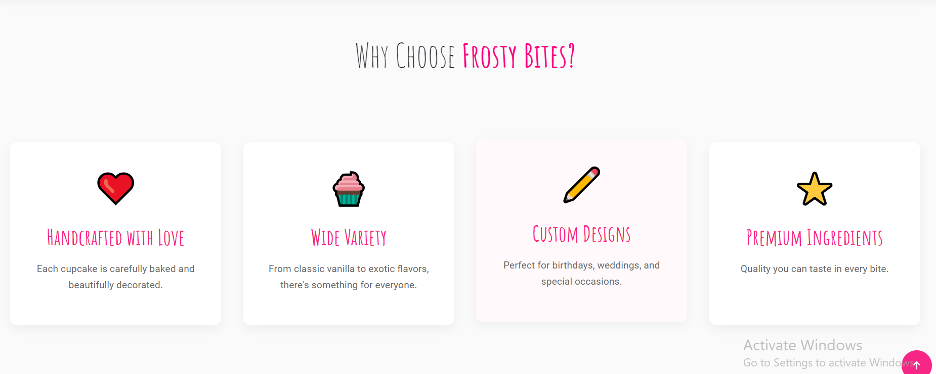
Why Choose Frosty Bites

Slide 4
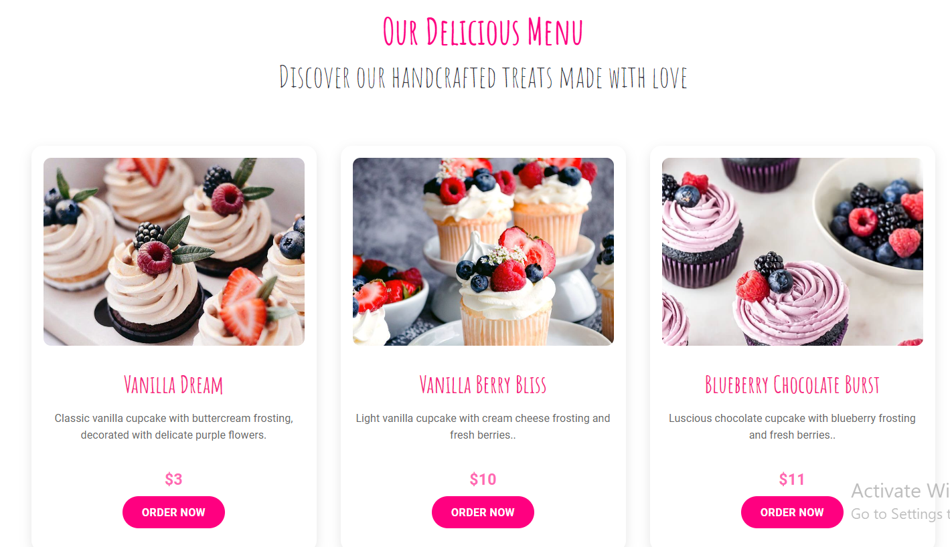
.

Slide 5
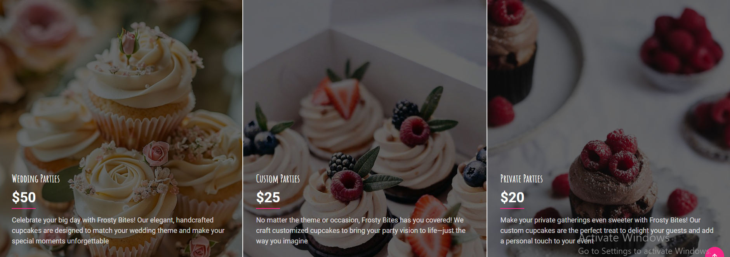
EVENT CUPCAKES

Slide 6
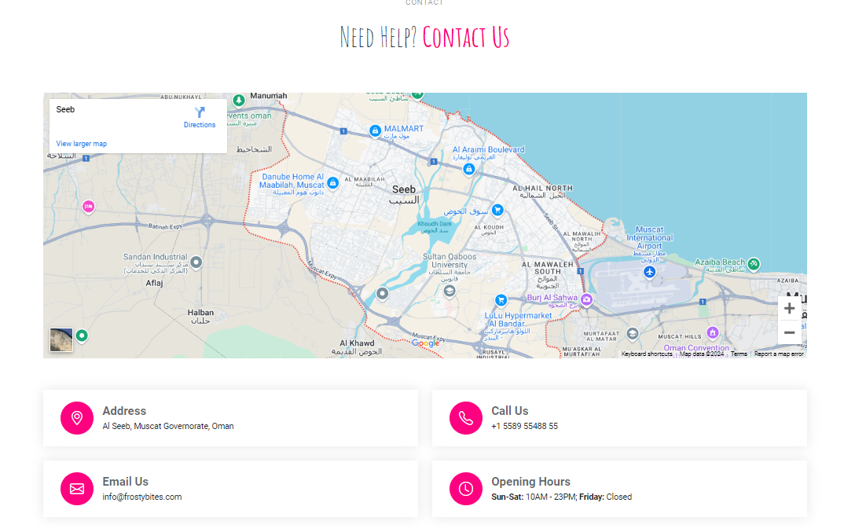

Slide 7
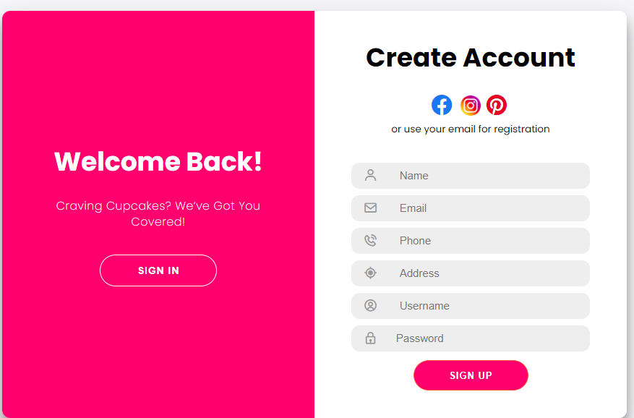
Registration form

Slide 8
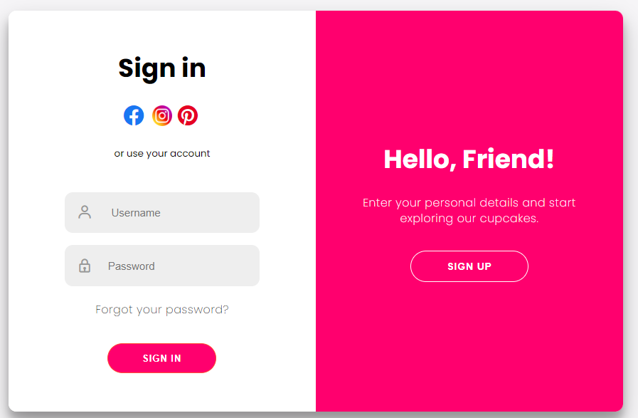
Login form

Slide 9
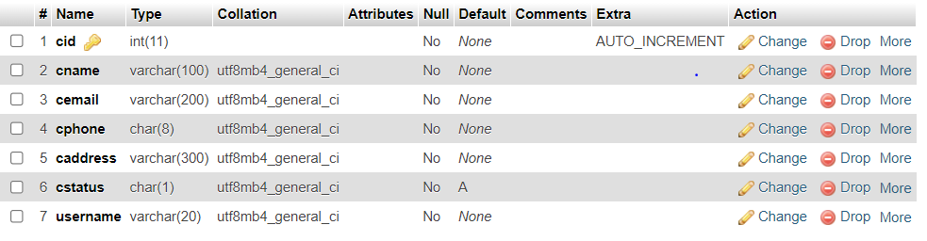
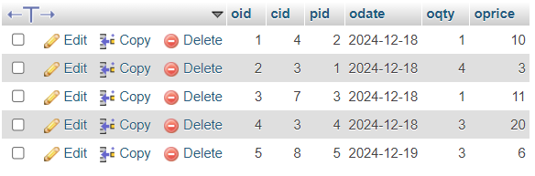
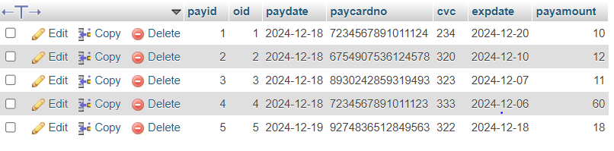
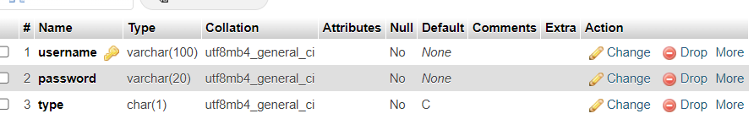
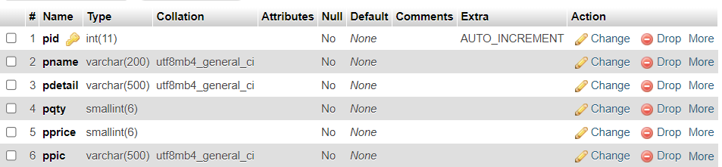
DATABASE TABLE
Order table :
Customer table :
Payment table :
User table :
Product table :

Slide 10
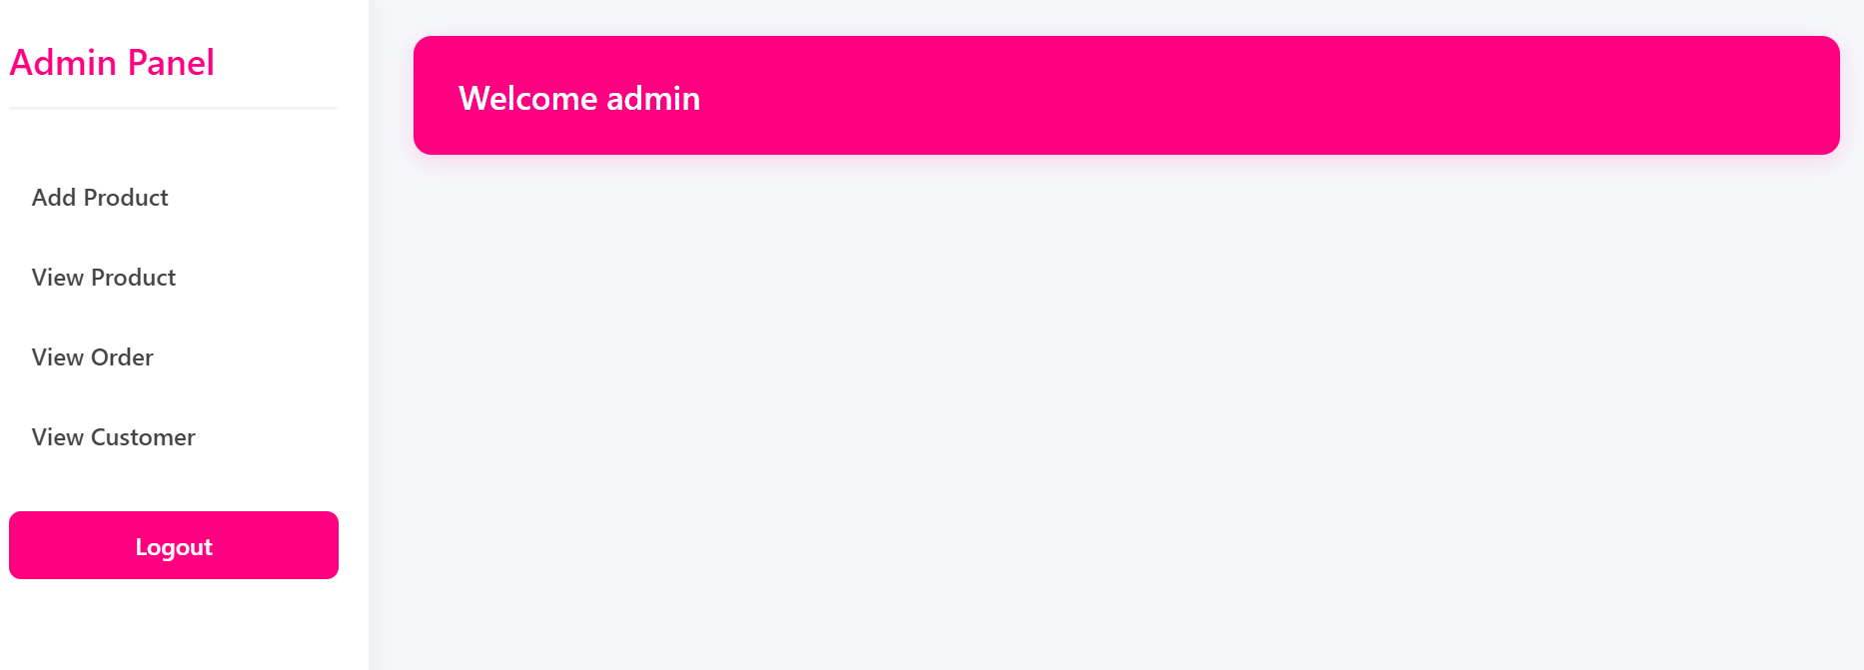
Admin Panel

Slide 11
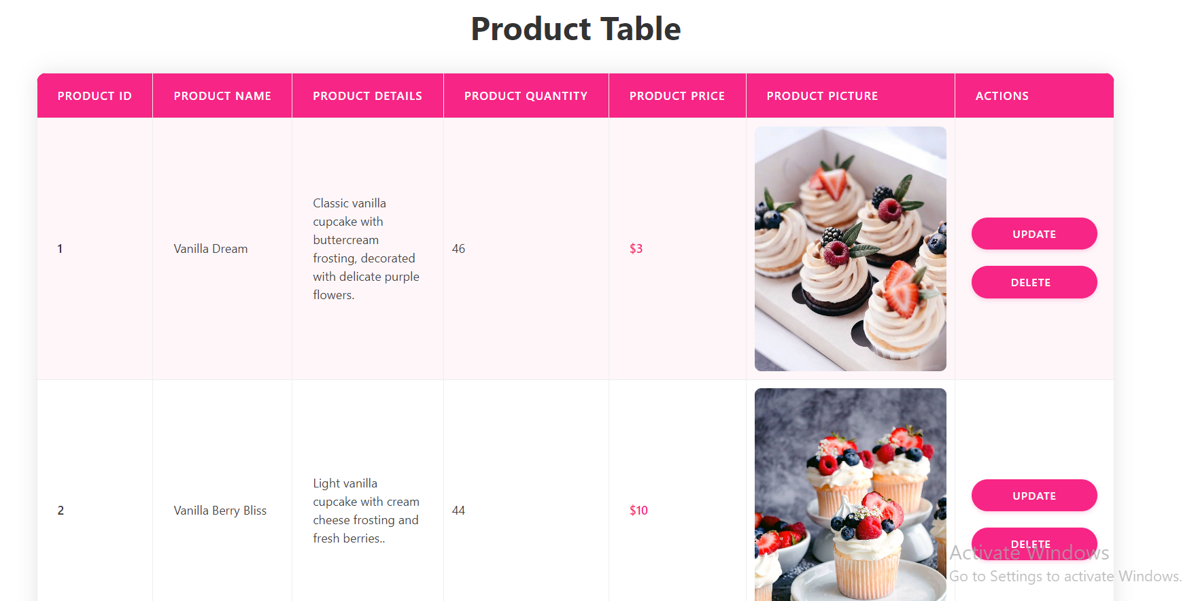

Slide 12
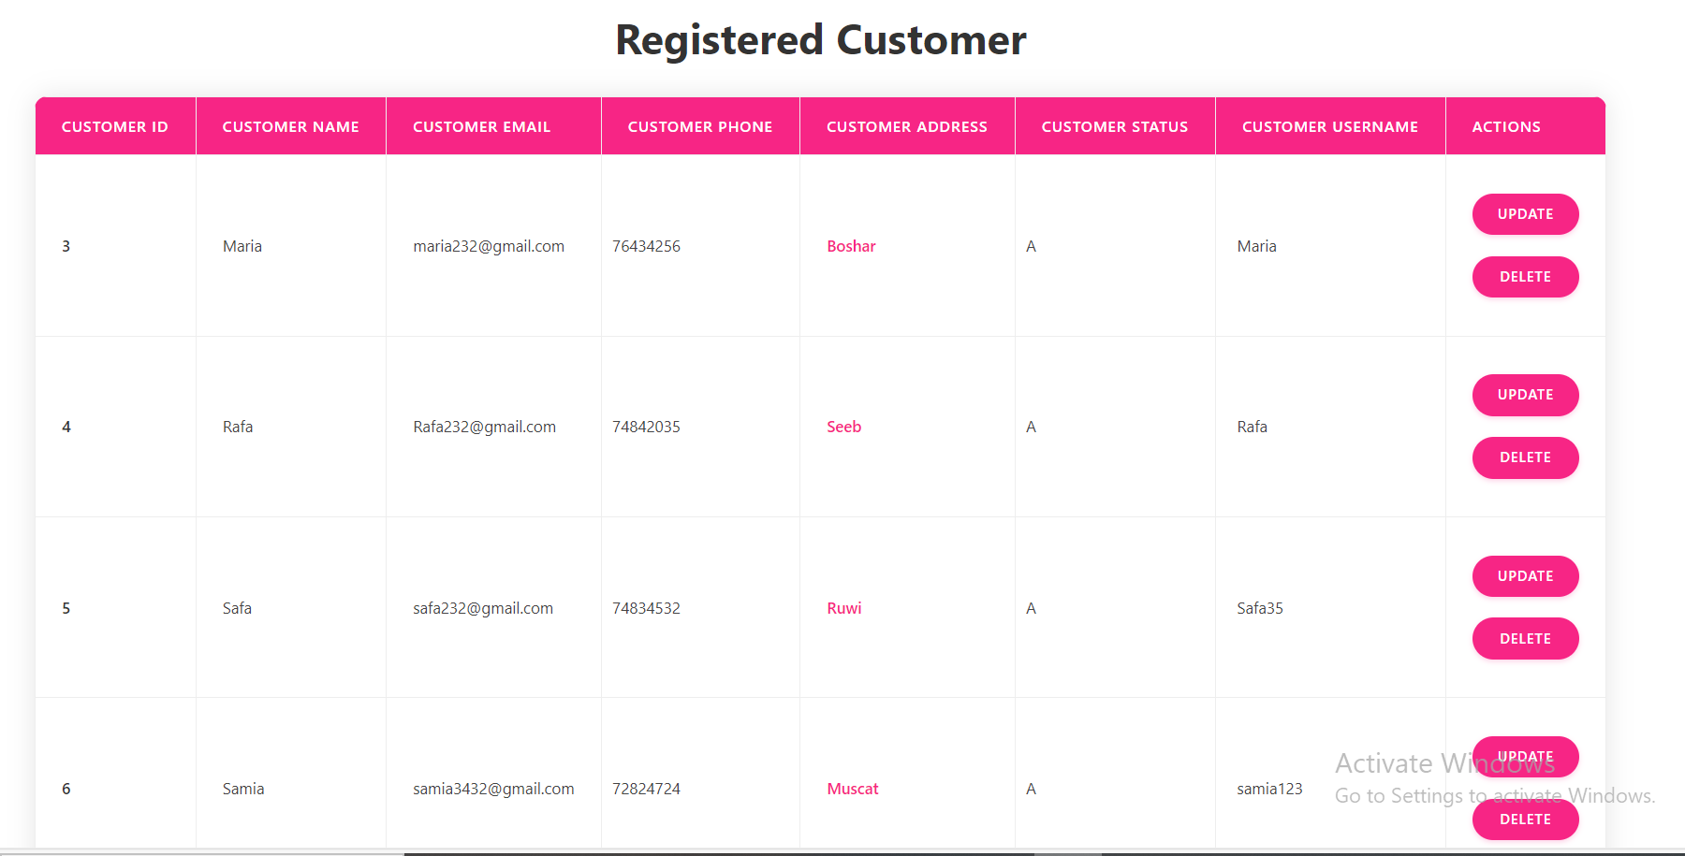

Slide 13
